Slide 1

<<P.W.A.S.>>
PRINTSHOP WORKFLOW
AUTOMATION SYSTEM
Development Team
Dulcardo Arteaga
Erik Kessler
Javier Mesa
Larissa Guerrero
Lenny Markus
Naveen Gowda
Rolando Vicaria
CEN 5011 – Fall 2006 – Term Project Presentation

Slide 2

Introduction
Proposed System
System Models
System Architecture
Subsystem Services
Packages
Testing
Demo
AGENDA

Slide 3
Introduction
Printing 101
Gang Run Printing
The Problem
The Solution
AGENDA

Slide 4
Purpose of the system
In a nutshell:
To facilitate and automate production for the customer.
To provide a uniform interface for customer order submission, order tracking, employee workflow, and management activities that will enhance productivity and efficiency.
INTRODUCTION

Slide 5
Scope of the system
The system will consist of a web based front-end for customers place orders and track progress; and a back end to allow managers and workers to receive, organize and schedule customer orders for production.
Billing will not be within the initial scope of the system, however, the system shall be easily extensible to support future
credit / debit features.
INTRODUCTION

Slide 6
Objectives & Success Criteria
Objective:
To centralize and streamline order entry and processing.
Success Scenario:
Order entry is done solely by customers, without need to call the print company.
No orders are lost due to human error during processing. Production times should be reduced from 3 to 1 business days
INTRODUCTION

Slide 7
Current system
Orders are submitted by customers, using various methods.
Employees receive individual orders and create corresponding job tickets based on the customer's requirements.
New orders are printed and placed in a folder. Orders are manually sorted and selected for print.
INTRODUCTION

Slide 8
Proposed System Overview
Web-Based order taking and tracking portal. It will allow customers to place and track orders online, providing them updates at each production milestone.
Employees can organize customer orders into print runs and track their completion status.
System administrators will be able to manage existing user accounts or add new ones.
INTRODUCTION

Slide 9
Functional Requirements
The system shall allow customers to place and track orders, utilizing a payment method of their choice.
The system shall allow customers to view their order history and account information.
The system shall allow employees to organize, track and complete customer orders.
The system shall allow administrators to manage user accounts, customer orders and printing properties.
The system shall have user access control for security and access differentiation.
PROPOSED SYSTEM

Slide 10
Non-Functional Requirements
Usability :
User interface should be understandable to non-technical customers.
The logo should not have any religious, political, racist, sexual, or discriminatory connotations.
Fonts should be clear and easy to read.
Color scheme should be light background with dark foreground, to maximize contrast.
There will be various help options for customers that explain the order submission and tracking processes.
PROPOSED SYSTEM

Slide 11
Non-Functional Requirements (Cont.)
Reliability:
The system should be highly available, with 99% up time.
Maintenance should not be required more than once a month.
PROPOSED SYSTEM

Slide 12
Non-Functional Requirements (Cont.)
Performance:
The system will respond within thirty seconds for any user action, including work-order submission, order tracking, and any other user interaction with the system.
The system should be available during business hours 99% of the time, with downtime allowed as specified by Section 3.3.2. of R.A.D.
PROPOSED SYSTEM

Slide 13
Non-Functional Requirements (Cont.)
Implementation:
The system will be web-based.
It will support Internet Explorer 7+ and Firefox 3+.
It should be implemented in a programming language that is cross-platform, so no porting will be required to change platforms
PROPOSED SYSTEM

Slide 14
Non-Functional Requirements (Cont.)
Supportability:
The system will not interfere with previously created orders or with the history of previous transactions.
The existing process for ordering will be supported by the system via a customer service employee
System maintenance should handle all updates required to fix defects, or handle change requests.
The system will be available only in English.
PROPOSED SYSTEM

Slide 15
Non-Functional Requirements (Cont.)
Interface:
The system shall be extensible to interface with a credit card processing service in the future. This functionality is not within the current scope of the system, as defined in Section 1.2.
Packaging:
Personalized installation/configuration will be offered by the software company. The product should be hosted internally by the print shop.
Legal:
None.
PROPOSED SYSTEM

Slide 16
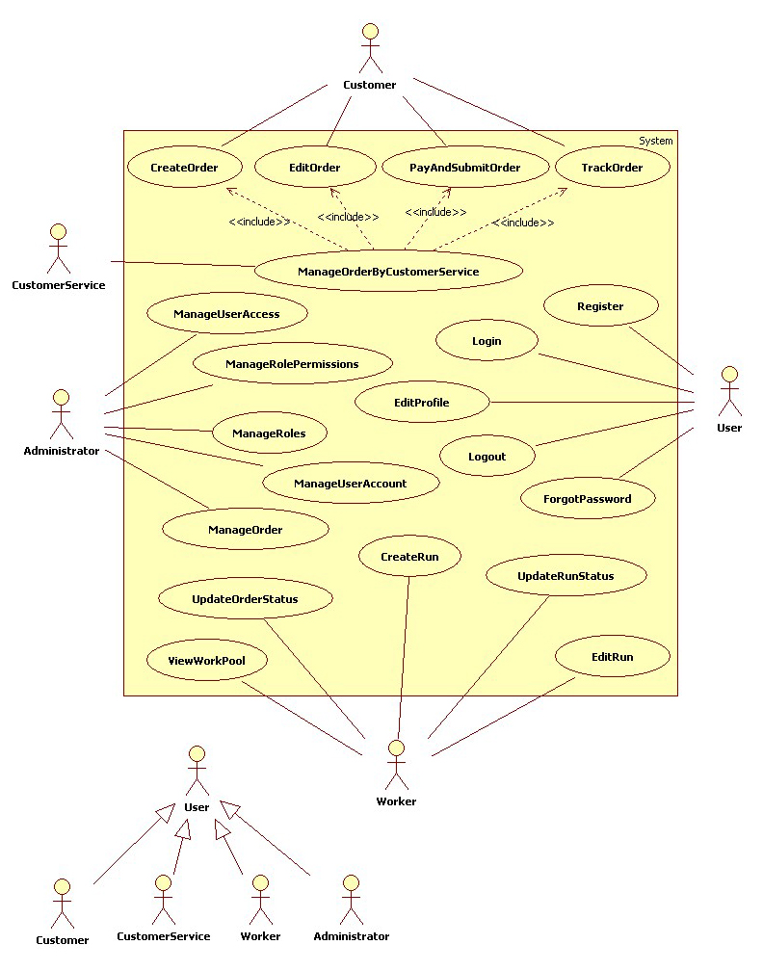
Use
Case
Models
SYSTEM MODELS

Slide 17
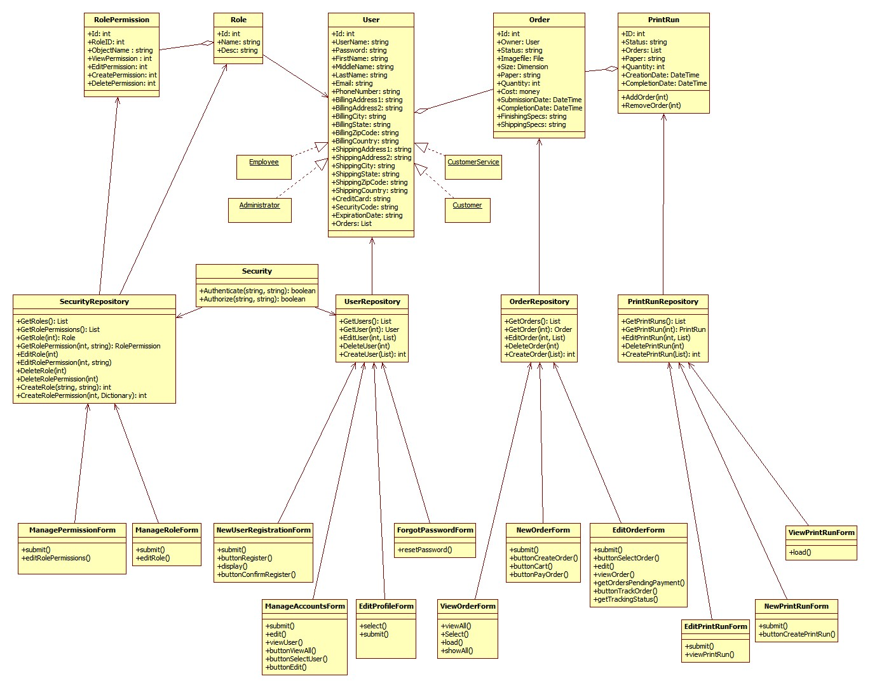
Object Model
SYSTEM MODELS

Slide 18
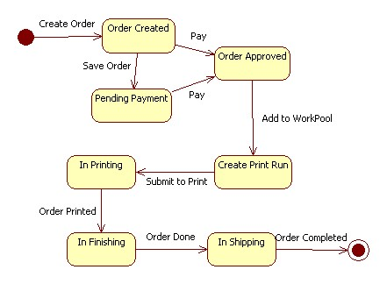
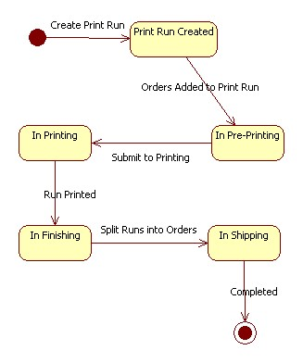
Dynamic Model
SYSTEM MODELS

Slide 19
Overview
Loose coupling on permanent storage side
Three Tiered Architecture
Use of design patterns
Repository pattern
Factory
Inversion of Control
SYSTEM ARCHITECTURE

Slide 20
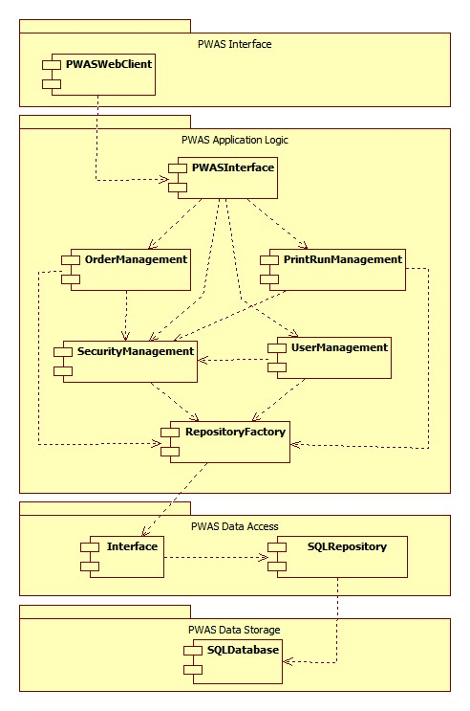
Subsystem Decomposition
SYSTEM ARCHITECTURE

Slide 21
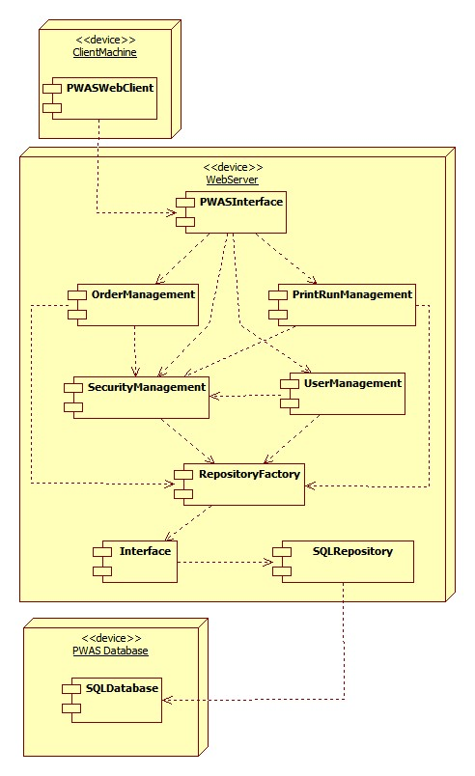
Hardware / Software Mapping
SYSTEM ARCHITECTURE

Slide 22
Persistent Data Management
Storage Strategy:
The system will maintain its data using a Relational Database, which will be managed with a Database Management System (DBMS). The DBMS will take care of concurrency and synchronization issues regarding the accessibility of the persistent data.
SYSTEM ARCHITECTURE

Slide 23
Persistent Data Management
Persistent Objects
Order
User
Run
OrdersToRuns Association
Roles
RolePermissions
SYSTEM ARCHITECTURE

Slide 24
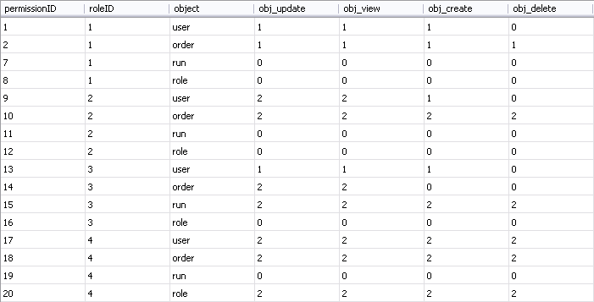
Access Control & Security
SYSTEM ARCHITECTURE

Slide 25
Global Software Control
The internal control flow of PWAS is event-driven. This is because the web server objects wait for requests from the web browser. When a request is received, the web server processes it and dispatches it to the appropriate page controller.
Page controllers are used to realize the boundary and control objects of PWAS. A preprocessor then generates views from the different page controllers. These controllers then invoke methods on entity objects and storage objects to allow for the functionality of our system.
SYSTEM ARCHITECTURE

Slide 26
Boundary Conditions
Installation:
Since PWAS is a web-based application, it does not need explicit installation execution. Instead PWAS files need to be copied to the WebServer.
Start-up:
The Administrator starts up the WebServer service making the PWAS system available to customers/workers. At this point the customers can connect to PWAS system by opening a web browser with PWAS web page address.
SYSTEM ARCHITECTURE

Slide 27
Boundary Conditions
Shutdown:
The administrator shuts down the WebServer’s service.
Exception Handling:
System maintenance will be done on weekends, between 12am and 7am, occurring less than twice per month and during this period the WebServer services will be shut down.
SYSTEM ARCHITECTURE

Slide 28
Subsystems
SYSTEM ARCHITECTURE

Slide 29
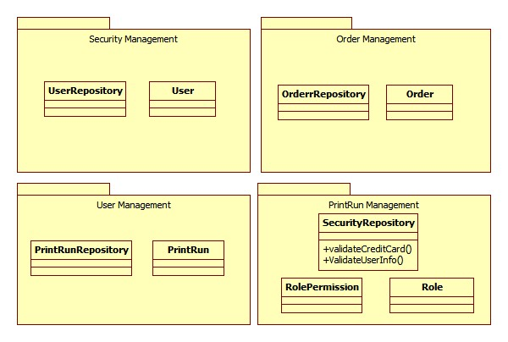
Packages
SYSTEM ARCHITECTURE

Slide 30
Testing
Functional/Integration Testing: Performed Automatically using Selenium/N Units testing tool.
Manual Testing: All use cases were tried out by hand, to ensure consistency with RAD.
TESTING

Slide 31
Demo

